Slide 1


FED TAPERING
CURRENCY DERIVATIVES

Slide 2

Understanding ‘Currency Derivatives’ – By Prof. Simply Simple TM

Slide 3

CURRENCY DERIVATIVES
One of the most exotic terms in derivative trading is ‘Currency Derivatives’.

Slide 4
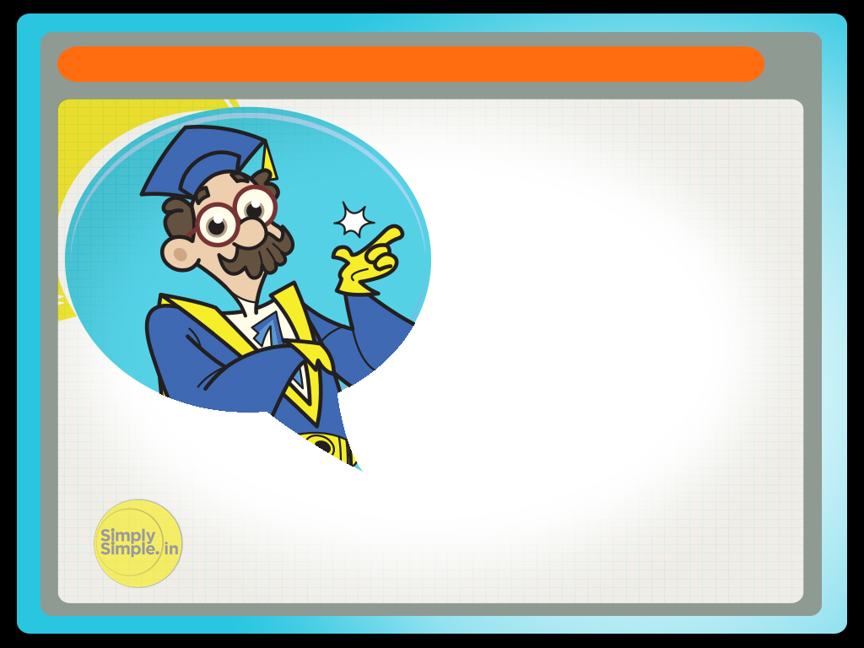
CURRENCY DERIVATIVES
But what are currency derivatives? And how are they transacted?
Let me try & simplify the term for you over the next few slides…

Slide 5


CURRENCY DERIVATIVES
Let’s say there is a farmer who grows tea in India, which is exported to the USA.

Slide 6

CURRENCY DERIVATIVES
And there is an importer of tea in the USA.
Let’s assume the current rate of exchange is Rs. 45 for 1 USD.

Slide 7
CURRENCY DERIVATIVES
Assume that the tea grower agrees to supply 10 quintals of tea to the importer at 10 dollars a quintal three months down the line upon harvesting.
(1 Quintal = 100 kgs)
It is important to understand that the importer buys tea at 10 dollars a quintal, no matter what the exchange rate is.

Slide 8
CURRENCY DERIVATIVES
The tea grower thinks that the rate of exchange, which is currently trading at Rs. 45 to a US dollar, could fall to Rs. 44 in 3 months.
This means that while the importer would pay her 100 dollars ( $10 per quintal x 10 quintals = $ 100), she would earn only Rs. 4400 ( $100 x Rs 44 per dollar) instead of Rs 4500 ( $100 x Rs 45 per dollar) thus incurring a loss of Rs. 100. ( Rs 4500 –Rs 4400)

Slide 9
CURRENCY DERIVATIVES
So the tea grower goes to a currency trader and signs a ‘forward contract’ which says that at the end of 3 months the currency trader would hedge her against a possible decrease in exchange rates.
This means that, at the end of 3 months, the currency trader would pay her Rs. 4500 for her 100 USD, no matter what the prevailing exchange rate.

Slide 10
CURRENCY DERIVATIVES
Such a contract is called a ‘Currency Derivatives’ contract because it is a currency contract that has to be executed at some future date.

Slide 11
CURRENCY DERIVATIVES
Now, let’s look at 3 different scenarios:
Say that after 3 months the rate of exchange remains Rs. 45 to a USD.
In this case the farmer will take the 100 USD she has received from the importer & go to the currency trader.
The trader will pay her Rs. 4500, as per the contract.
So the tea grower makes Rs. 4500 in all.

Slide 12
CURRENCY DERIVATIVES
Now, let’s look at the 2nd scenario:
Say that after 3 months the rate of exchange reaches Rs. 46 to a USD
(i.e. $100 = Rs 4600)
In this case the farmer’s call was wrong. She will take the 100 USD she has received from the importer & go to the currency trader.
The trader will pay her Rs. 4500, as per the contract and would sell off the 100 USD in the market for Rs. 4600, thus making a profit of Rs. 100.

Slide 13
CURRENCY DERIVATIVES
Now, let’s look at the 3rd scenario:
Say that after 3 months the rate of exchange drops to Rs. 44 to a USD.
($100 = Rs 4400)
In this case the farmer’s call was right. She will take the 100 USD she has received from the importer & go to the currency trader.
The trader will pay her Rs. 4500, as per the contract thus incurring a loss of Rs. 100.

Slide 14
CURRENCY DERIVATIVES
Thus, while the tea grower may not make any profit if the rupee becomes weaker against the dollar, she will definitely profit if the rupee appreciates & drops below Rs. 45.
But at least she would have been at peace for the period of 3 months since she remained protected against any kind of fall in the rupee.

Slide 15
CURRENCY DERIVATIVES
Hope you have now clearly understood the meaning of ‘currency derivatives’ and its practical application.

Slide 16
CURRENCY DERIVATIVES
Hope this story succeeded in clarifying the concept of ‘Currency Derivatives’

Slide 17

Please give us your feedback at
professor@tataamc.com

Slide 18

DISCLAIMER
The views expressed in this lesson are for information purposes only and do not construe to be any investment, legal or taxation advice. The lesson is a conceptual representation and may not include several nuances that are associated and vital. The purpose of this lesson is to clarify the basics of the concept so that readers at large can relate and thereby take more interest in the product / concept. In a nutshell, Professor Simply Simple lessons should be seen from the perspective of it being a primer on financial concepts. The contents are topical in nature and held true at the time of creation of the lesson. This is not indicative of future market trends, nor is Tata Asset Management Ltd. attempting to predict the same. Reprinting any part of this material will be at your own risk. Tata Asset Management Ltd. will not be liable for the consequences of such action.
Mutual Fund investments are subject to market risks, read all scheme related documents carefully.

